Slide 1

CLASS 35 CD-404 EXPLORATORY DATA ANALYSIS UNIT 3
EXPLORATORY DATA ANALYSIS
Prof. Vineeta Shrivastava
Assistant Professor
Department of Computer Science & Engineering
LNCT-E, Bhopal
Lakshmi Narain College of Technology Excellence, Bhopal

Slide 2
CLASS 35 CD-404 EXPLORATORY DATA ANALYSIS UNIT 3
AGENDA
EXPLORATORY DATA ANALYSIS
Importance of EDA
Types of EDA
Tools for EDA
Steps involved in EDA
Prof. Vineeta Shrivastava
Assistant Professor
Department of Computer Science & Engineering
LNCT-E, Bhopal
Lakshmi Narain College of Technology Excellence, Bhopal

Slide 3
CLASS 35 CD-404 EXPLORATORY DATA ANALYSIS UNIT 3
What Is Exploratory Data Analysis?
Exploratory Data Analysis is a data analytics process to understand the data in depth and learn the different data characteristics, often with visual means.
This allows us to get a better feel of our data and find useful patterns in it.
Prof. Vineeta Shrivastava
Assistant Professor
Department of Computer Science & Engineering
LNCT-E, Bhopal
Lakshmi Narain College of Technology Excellence, Bhopal

Slide 4
CLASS 35 CD-404 EXPLORATORY DATA ANALYSIS UNIT 3
Exploratory data analysis (EDA) is used by data scientists to analyse and investigate data sets and summarize their main characteristics, often employing data visualization methods.
EDA helps to determine how best to manipulate data sources to get the answers we need, making it easier for data scientists to discover patterns, spot anomalies, test a hypothesis, or check assumptions.
Prof. Vineeta Shrivastava
Assistant Professor
Department of Computer Science & Engineering
LNCT-E, Bhopal
Lakshmi Narain College of Technology Excellence, Bhopal

Slide 5
CLASS 35 CD-404 EXPLORATORY DATA ANALYSIS UNIT 3
EDA is primarily used to see what data can reveal beyond the formal modeling or hypothesis testing task and provides a better understanding of data set variables and the relationships between them.
It can also help determine if the statistical techniques we are considering for data analysis are appropriate or not.
Originally developed by American mathematician John Tukey in the 1970s, EDA techniques continue to be a widely used method in the data discovery process today.
Prof. Vineeta Shrivastava
Assistant Professor
Department of Computer Science & Engineering
LNCT-E, Bhopal
Lakshmi Narain College of Technology Excellence, Bhopal

Slide 6
CLASS 35 CD-404 EXPLORATORY DATA ANALYSIS UNIT 3
Importance
It is crucial to understand the data in depth before we perform data analysis and run our data through an algorithm.
We need to know the patterns in our data and determine which variables are important and which do not play a significant role in the output.
Further, some variables may have correlations with other variables. We also need to recognize errors in our data.
Prof. Vineeta Shrivastava
Assistant Professor
Department of Computer Science & Engineering
LNCT-E, Bhopal
Lakshmi Narain College of Technology Excellence, Bhopal

Slide 7
CLASS 35 CD-404 EXPLORATORY DATA ANALYSIS UNIT 3
All of this can be done with Exploratory Data Analysis.
It helps us to gather insights and make better sense of the data, and removes irregularities and unnecessary values from data.
Helps us to prepare our dataset for analysis.
Allows a machine learning model to predict our dataset better.
Gives us more accurate results.
It also helps us to choose a better machine learning model.
Prof. Vineeta Shrivastava
Assistant Professor
Department of Computer Science & Engineering
LNCT-E, Bhopal
Lakshmi Narain College of Technology Excellence, Bhopal

Slide 8
CLASS 35 CD-404 EXPLORATORY DATA ANALYSIS UNIT 3
The main purpose of EDA is to help look at data before making any assumptions.
It can help identify obvious errors, as well as better understand patterns within the data, detect outliers or anomalous events, find interesting relations among the variables.
Prof. Vineeta Shrivastava
Assistant Professor
Department of Computer Science & Engineering
LNCT-E, Bhopal
Lakshmi Narain College of Technology Excellence, Bhopal

Slide 9
CLASS 35 CD-404 EXPLORATORY DATA ANALYSIS UNIT 3
Data scientists can use exploratory analysis to ensure the results they produce are valid and applicable to any desired business outcomes and goals.
EDA also helps stakeholders by confirming they are asking the right questions.
EDA can help answer questions about standard deviations, categorical variables, and confidence intervals.
Once EDA is complete and insights are drawn, its features can then be used for more sophisticated data analysis or modeling, including machine learning.
Prof. Vineeta Shrivastava
Assistant Professor
Department of Computer Science & Engineering
LNCT-E, Bhopal
Lakshmi Narain College of Technology Excellence, Bhopal

Slide 10
CLASS 35 CD-404 EXPLORATORY DATA ANALYSIS UNIT 3
Types of EDA
There are four primary types of EDA:
Univariate non-graphical.
Univariate graphical.
Multivariate non-graphical.
Multivariate graphical.
Prof. Vineeta Shrivastava
Assistant Professor
Department of Computer Science & Engineering
LNCT-E, Bhopal
Lakshmi Narain College of Technology Excellence, Bhopal

Slide 11
CLASS 35 CD-404 EXPLORATORY DATA ANALYSIS UNIT 3
Univariate non-graphical.
This is simplest form of data analysis, where the data being analyzed consists of just one variable.
Since it’s a single variable, it doesn’t deal with causes or relationships.
The main purpose of univariate analysis is to describe the data and find patterns that exist within it.
Prof. Vineeta Shrivastava
Assistant Professor
Department of Computer Science & Engineering
LNCT-E, Bhopal
Lakshmi Narain College of Technology Excellence, Bhopal

Slide 12
CLASS 35 CD-404 EXPLORATORY DATA ANALYSIS UNIT 3
The standard goal of univariate non-graphical EDA is to know the underlying sample distribution or data and make observations about the population.
Outlier detection is additionally part of the analysis.
The characteristics of population distribution include:
Central tendency
Spread
Skewness and kurtosis
Prof. Vineeta Shrivastava
Assistant Professor
Department of Computer Science & Engineering
LNCT-E, Bhopal
Lakshmi Narain College of Technology Excellence, Bhopal

Slide 13
CLASS 35 CD-404 EXPLORATORY DATA ANALYSIS UNIT 3
Univariate graphical.
Non-graphical methods don’t provide a full picture of the data.
Non-graphical methods are quantitative and objective, they are not able to give the complete picture of the data; therefore, graphical methods are used more as they involve a degree of subjective analysis, also are required.
Prof. Vineeta Shrivastava
Assistant Professor
Department of Computer Science & Engineering
LNCT-E, Bhopal
Lakshmi Narain College of Technology Excellence, Bhopal

Slide 14
CLASS 35 CD-404 EXPLORATORY DATA ANALYSIS UNIT 3
Common types of univariate graphics include:
Stem-and-leaf plots
Histograms
Box plots
Prof. Vineeta Shrivastava
Assistant Professor
Department of Computer Science & Engineering
LNCT-E, Bhopal
Lakshmi Narain College of Technology Excellence, Bhopal

Slide 15
CLASS 35 CD-404 EXPLORATORY DATA ANALYSIS UNIT 3
Stem-and-leaf plots, which show all data values and the shape of the distribution.
Histograms, a bar plot in which each bar represents the frequency (count) or proportion (count/total count) of cases for a range of values.
Box plots, which graphically depict the five-number summary of minimum, first quartile, median, third quartile, and maximum.
Prof. Vineeta Shrivastava
Assistant Professor
Department of Computer Science & Engineering
LNCT-E, Bhopal
Lakshmi Narain College of Technology Excellence, Bhopal

Slide 16
CLASS 35 CD-404 EXPLORATORY DATA ANALYSIS UNIT 3
Multivariate non graphical:
Multivariate data arises from more than one variable.
Multivariate non-graphical EDA techniques generally show the relationship between two or more variables of the data through cross-tabulation or statistics.
Prof. Vineeta Shrivastava
Assistant Professor
Department of Computer Science & Engineering
LNCT-E, Bhopal
Lakshmi Narain College of Technology Excellence, Bhopal

Slide 17
CLASS 35 CD-404 EXPLORATORY DATA ANALYSIS UNIT 3
Multivariate graphical:
Multivariate data uses graphics to display relationships between two or more sets of data.
The most used graphic is a grouped bar plot or bar chart with each group representing one level of one of the variables and each bar within a group representing the levels of the other variable.
Prof. Vineeta Shrivastava
Assistant Professor
Department of Computer Science & Engineering
LNCT-E, Bhopal
Lakshmi Narain College of Technology Excellence, Bhopal

Slide 18
CLASS 35 CD-404 EXPLORATORY DATA ANALYSIS UNIT 3
Other common types of multivariate graphics include:
Scatter plot, which is used to plot data points on a horizontal and a vertical axis to show how much one variable is affected by another.
Multivariate chart, which is a graphical representation of the relationships between factors and a response.
Run chart, which is a line graph of data plotted over time.
Bubble chart, which is a data visualization that displays multiple circles (bubbles) in a two-dimensional plot.
Heat map, which is a graphical representation of data where values are depicted by colour.
Prof. Vineeta Shrivastava
Assistant Professor
Department of Computer Science & Engineering
LNCT-E, Bhopal
Lakshmi Narain College of Technology Excellence, Bhopal

Slide 19
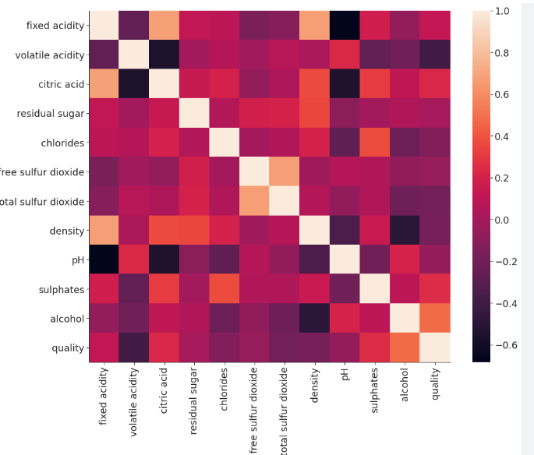
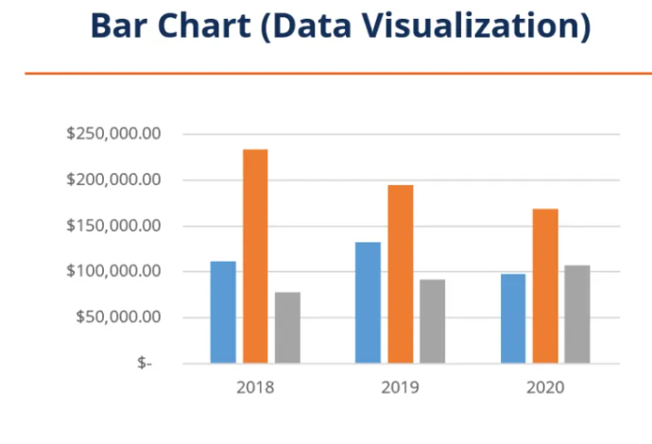
CLASS 35 CD-404 EXPLORATORY DATA ANALYSIS UNIT 3
Prof. Vineeta Shrivastava
Assistant Professor
Department of Computer Science & Engineering
LNCT-E, Bhopal
Lakshmi Narain College of Technology Excellence, Bhopal

Slide 20
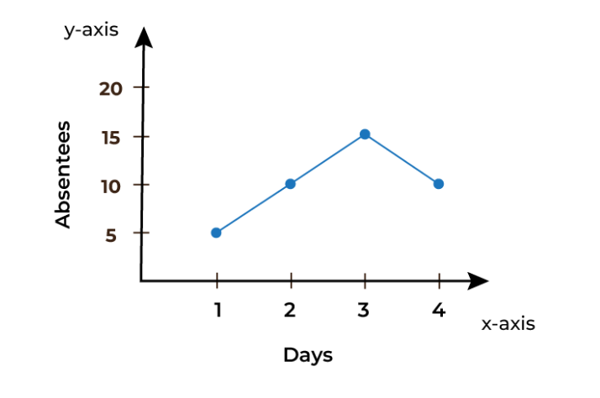
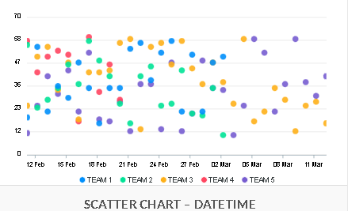
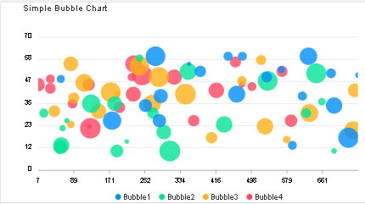
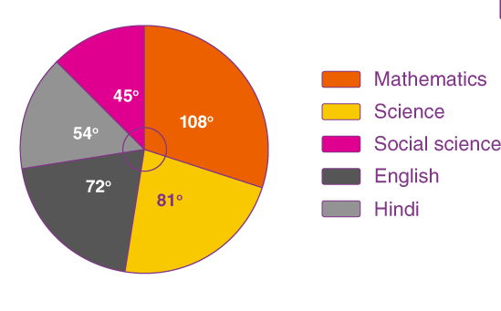
CLASS 35 CD-404 EXPLORATORY DATA ANALYSIS UNIT 3
Prof. Vineeta Shrivastava
Assistant Professor
Department of Computer Science & Engineering
LNCT-E, Bhopal
Lakshmi Narain College of Technology Excellence, Bhopal

Slide 21
CLASS 35 CD-404 EXPLORATORY DATA ANALYSIS UNIT 3
TOOLS REQUIRED FOR EXPLORATORY DATA ANALYSIS:
R
Python
Prof. Vineeta Shrivastava
Assistant Professor
Department of Computer Science & Engineering
LNCT-E, Bhopal
Lakshmi Narain College of Technology Excellence, Bhopal

Slide 22
CLASS 35 CD-404 EXPLORATORY DATA ANALYSIS UNIT 3
Steps involved in EDA
Data Collection
Finding all Variables and Understanding Them
Cleaning the Dataset
Identify Correlated Variables
Choosing the Right Statistical Methods
Visualizing and Analyzing Results
Prof. Vineeta Shrivastava
Assistant Professor
Department of Computer Science & Engineering
LNCT-E, Bhopal
Lakshmi Narain College of Technology Excellence, Bhopal

Slide 23
CLASS 35 CD-404 EXPLORATORY DATA ANALYSIS UNIT 3
Advantages of Using EDA
Gain Insights Into Underlying Trends and Patterns
Improved Understanding of Variables
Better Pre-process Data to Save Time
Make Data-driven Decisions
Prof. Vineeta Shrivastava
Assistant Professor
Department of Computer Science & Engineering
LNCT-E, Bhopal
Lakshmi Narain College of Technology Excellence, Bhopal

Slide 24
CLASS 35 CD-404 EXPLORATORY DATA ANALYSIS UNIT 3
Some key takeaways:
EDA is subjective as it summarizes the features and characteristics of a dataset.
So, depending on the project, data scientists can choose from the various plots discussed to explore the data before applying machine learning algorithms.
Since the nature of EDA depends on the data, we can say that it is an approach instead of a defined process.
Prof. Vineeta Shrivastava
Assistant Professor
Department of Computer Science & Engineering
LNCT-E, Bhopal
Lakshmi Narain College of Technology Excellence, Bhopal

Slide 25
CLASS 35 CD-404 EXPLORATORY DATA ANALYSIS UNIT 3
EDA presents hidden insights from data through visualizations such as graphs and plots.
Graphical and non-graphical statistical methods can be used to perform EDA.
Univariate analysis is simpler than multivariate analysis.
The success of any EDA will depend on the quality and quantity of data, the choice of tools and visualization, and its proper interpretation by a data scientist.
EDA is crucial in AI-driven businesses such as retail, e-commerce, banking and finance, agriculture, healthcare, and so on.
Prof. Vineeta Shrivastava
Assistant Professor
Department of Computer Science & Engineering
LNCT-E, Bhopal
Lakshmi Narain College of Technology Excellence, Bhopal

Slide 26
CLASS 35 CD-404 EXPLORATORY DATA ANALYSIS UNIT 3
THANKYOU
Prof. Vineeta Shrivastava
Assistant Professor
Department of Computer Science & Engineering
LNCT-E, Bhopal
Lakshmi Narain College of Technology Excellence, Bhopal

